Slide 1
MODULES
Image acquisition
Face detection algorithm
Distance measurement
Alert system
Parental Control

Slide 2
Image Acquisition:
DFD: Level 0
Image acquisition
Binarization
Foreground detection
Foreground object values

Slide 3
Face detection algorithm:
DFD: Level 1
Foreground object
Facial features extraction
HAAR Cascade algorithm
Facial bounding features detection

Slide 4
ALGORITHM AND TECHNIQUES
STEPS OF HAAR CASCADE ALGORITHM
Pick a pixel location from the image.
Now crop a sub-image with the selected pixel as the center from the source image with the same size as the convolution kernel.
Calculate an element-wise product between the values of the kernel and sub- image and add the result of the image.
Put the resultant value into the new image at the same place where you picked up the pixel location.

Slide 5
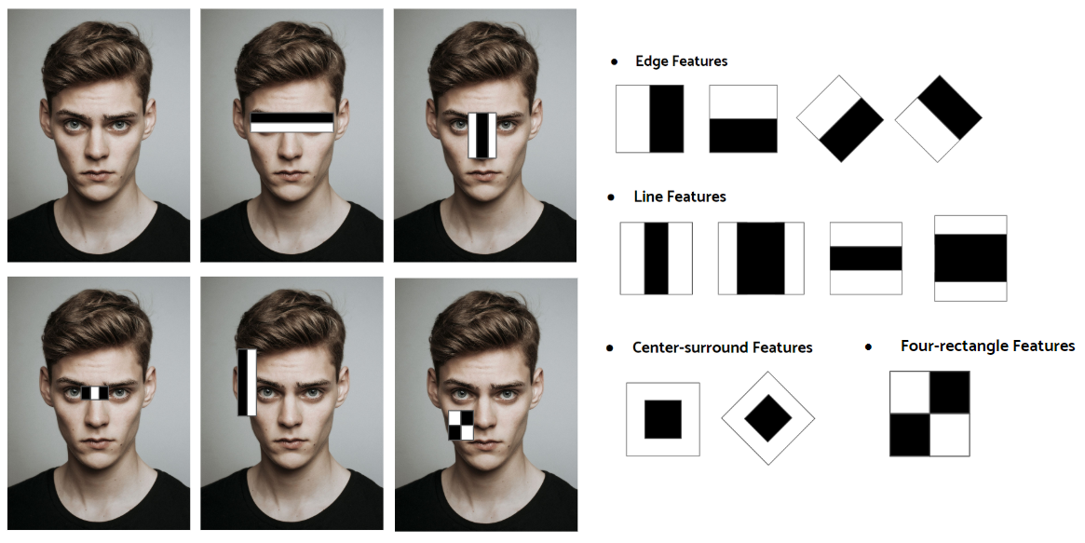

Slide 6
CONVOLUTIONAL NEURAL NETWORK
It is a method used in artificial neural networks to calculate a gradient that is needed in the calculation of the weights to be used in the network.
Randomly initialize the weights and biases.
Feed the training sample.
Propagate the inputs forward compute the net input and output of each unit in the hidden and output layers.

Slide 7
CONVOLUTIONAL NEURAL NETWORK
Convolution of the error to the hidden layer.
Update weights and biases to reflect the propagated errors.
Training and learning functions are mathematical procedures used to automatically adjust the network's weights and biases.
Terminating condition.

Slide 8
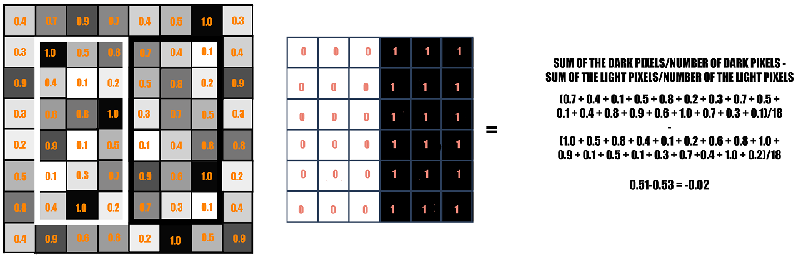

Slide 9
Distance measurements:
DFD: Level 2
Bounding box height and width values
Bounding box of faces
Height threshold value calculation

Slide 10
Alert system:
DFD: Level 3
Threshold values checking
Near into the system
Far away from system
Alert system
Constant seeing

Slide 11
Parental Control:
DFD: Level 4
Parental control
Face recognition
Unwanted web site seeing
Alert system (Message alert and Mail alert)

Slide 12
THANK YOU

